Slide 1
Lesson 5.2
Energy Transformations

Slide 2
Vocabulary
law of conservation of energy
friction

Slide 3
Essential Questions
1
What is the law of conservation of energy?
2
How does friction affect energy transformations?
3
How are different types of energy used?

Slide 4
Explore Activity
Woosh!
On a hot summer day, there’s no place better to cool off than a water park.
Image you have just ridden a water slide.
Energy is present in the water slide.
Brainstorm with a partner what energies are present and list them below.
Predict where the energies are the greatest and the least.

Slide 5
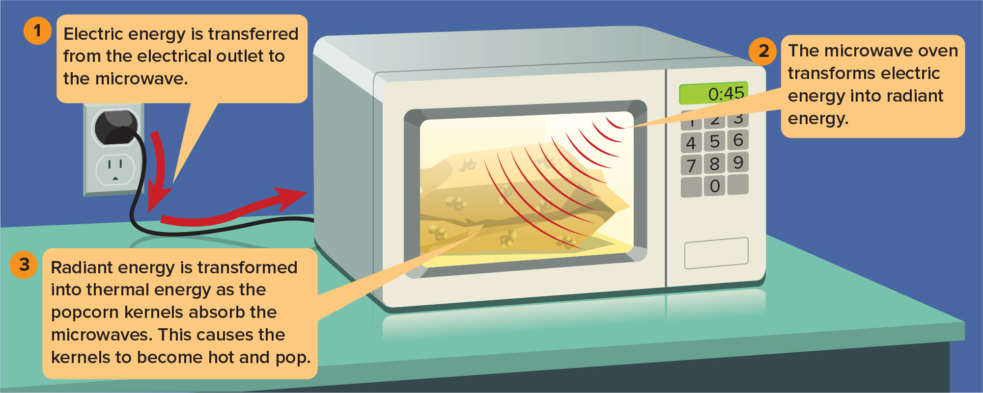
Changes Between Forms of Energy
The changes from electric energy to radiant energy to thermal energy are called energy transformations.

Slide 6
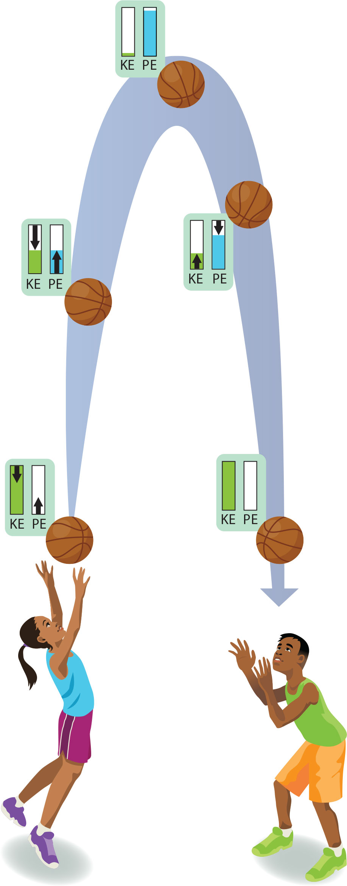
Changes Between Kinetic and Potential Energy
Energy transformations also occur when you toss a ball upward. The ball slows down as it moves upward and then speeds up as it moves downward. The ball’s speed and height change as energy changes from one form to another.

Slide 7
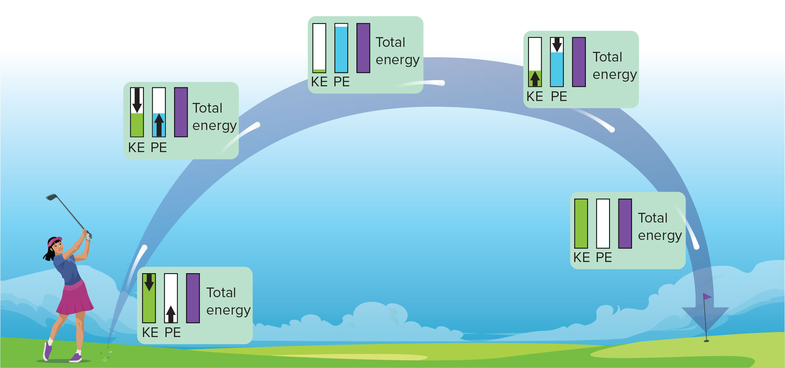
The Law of Conservation of Energy
According to the law of conservation of energy, energy can be transformed from one form into another or transferred from one region to another, but energy cannot be created or destroyed.

Slide 8
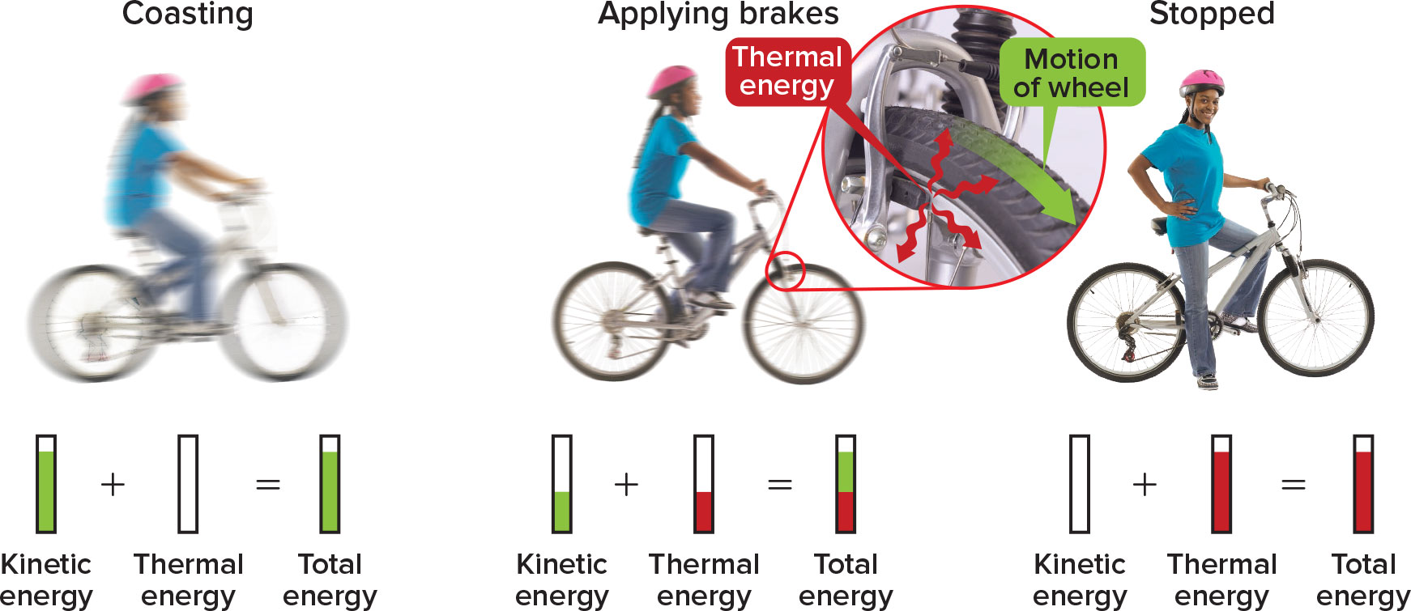
Friction and the Law of Conservation of Energy
Friction between the bicycle’s brake pads and the moving wheels transforms mechanical energy into thermal energy. Friction is a force that resists the sliding of two surfaces that are touching.
(l, cr, cl, r)Richard Hutchings

Slide 9
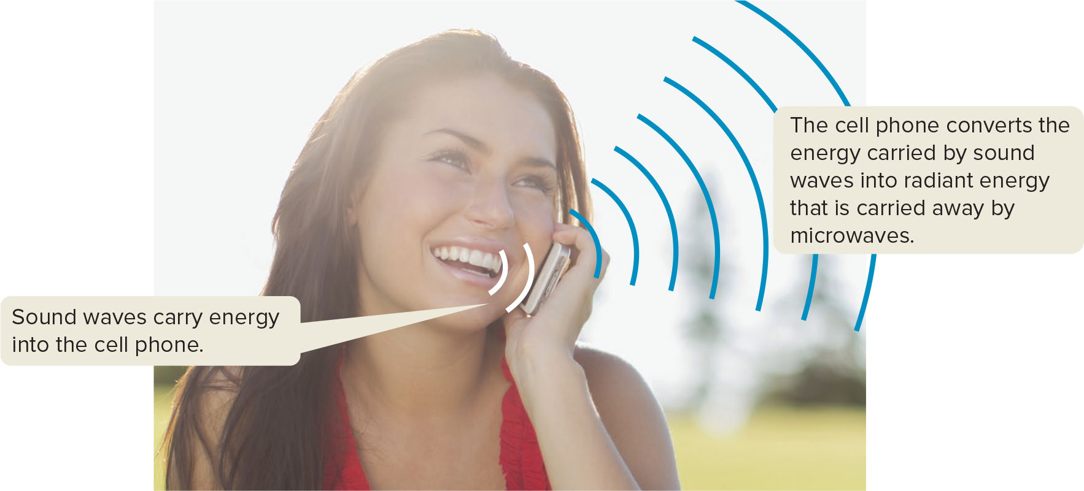
Using Energy
Every day you use different forms of energy to do different things. You might use the radiant energy from a lamp to light a room, or you might use the chemical energy stored in your body to run a race. When you use energy, you usually change it from
one form into another.
Hero/Fancy/Corbis/Glow Images

Slide 10
Gravitational Potential Energy

Slide 11
Mini-Assessment
1.
A pendulum bob swings back and forth in an arc. Which describes the energy conversion process as the pendulum moves from left to right?
A
kinetic energy to chemical energy to
potential energy
B
kinetic energy to potential energy back to kinetic energy
C
potential energy to kinetic energy back
to potential energy
CORRECT
D
potential energy to kinetic energy to
electromagnetic energy

Slide 12
Mini-Assessment
2.
According to the law of conservation of energy, what happens to the total amount of energy in the universe?
A
It remains constant.
CORRECT
B
It changes constantly.
C
It increases.
D
It decreases.

Slide 13
Mini-Assessment
3.
A girl drops the ball she is holding. Which best explains the energy transformation taking place in the system?
A
The ball in her hands has kinetic energy. When it falls, the kinetic energy changes to potential energy.
B
The ball in her hands has potential energy. When it falls, the potential energy changes to kinetic energy.
CORRECT
C
The ball in her hands has potential energy. When it falls, the potential energy remains constant.
D
The ball in her hands has kinetic energy. When it falls, the kinetic energy remains constant.

Slide 14
Mini-Assessment
4.
Which statement about energy transformations is not true?
A
All forms of energy can be transformed into thermal energy.
B
Energy is never destroyed or created during transformations.
C
Potential chemical energy always transforms into kinetic energy.
CORRECT
D
Some thermal energy is always released
during a transformation.

Slide 15
Mini-Assessment
5.
When a ball is thrown upward, where does it have the least kinetic energy?
A
at its lowest point when it is moving downward
B
at its lowest point when it is moving upward
C
midway between its highest point and its lowest point
D
at its highest point
CORRECT

Slide 16
Mini-Assessment
6.
A rock falls from a ledge to the ground. What energy conversion occurs during this process?
A
Potential energy is converted into kinetic energy.
CORRECT
B
Kinetic energy is converted into potential energy.
C
Thermal energy is converted into mechanical energy.
D
Chemical energy is converted into mechanical energy.

